Slide 1
E-commerce Product Delivery Prediction
Submitted by - Vishal Kulkarni

Slide 2
AGENDA
Project Objective
Dataset Overview
Data Preprocessing
Exploratory Data Analysis
Correlation Analysis
Model Training
Model Evaluation
Conclusion

Slide 3
Project Overview
Objective:
To conduct Exploratory Data Analysis based on the data set to explore relationships between features of the dataset and the target label such as Delivery success
The project focuses on predicting whether products will reach customers on time using machine learning models.
Understand key factors influencing delivery times (e.g., product properties, customer behaviour).

Slide 4
Data Set
Data Collection, Exploration & Cleaning
END TO END DEPLOYEMENT FLOW
Data Pre- Processing & Feature Engineering
Data Modeling Selection & Training
Evaluation of Model & Optimization
Model Deployment
User

Slide 5
Dataset Overview
Dataset Summary:
Total Records: 10,999 rows.
Features: 12 columns including:
Warehouse_block, Mode_of_Shipment, Customer_care_calls, Cost_of_the_Product, Weight_in_gms, and Reached.on.Time_Y.N.
Target Variable: Reached.on.Time.Y.N (1: On-time, 0: Delayed).
Key Attributes:
Warehouse_block: Source of the shipment (A to F).
Mode_of_Shipment: Transport method (Ship, Flight, Road).
Discount_offered: Promotional discounts.
Product_importance: Importance level (low, medium, high).

Slide 6
Data Preprocessing
Steps Followed:
Checked for missing values: No missing data was found.
Converted categorical variables to numerical using one-hot encoding for Gender, Warehouse_block,.
Converted categorical variables to numerical using encoding (e.g. ordinal encoding for product importance).
Split data into training (80%) and testing (20%) sets for model building.

Slide 7
Exploratory Data Analysis
1.Gender Distribution:
Nearly equal representation of male and female customers (~50% each).
2.Product Insights:
Heavier products (2500-3500 grams) are more likely delivered on time.
Products costing below $250 are more punctual compared to higher-cost items.
3.Customer Behavior:
High customer care calls often indicate delayed delivery.
Repeat customers have better delivery outcomes.
4.Discount Impact:
Minimal discounts (0-10%) lead to more late deliveries.
Higher discounts (>10%) correlate with timely deliveries.

Slide 8
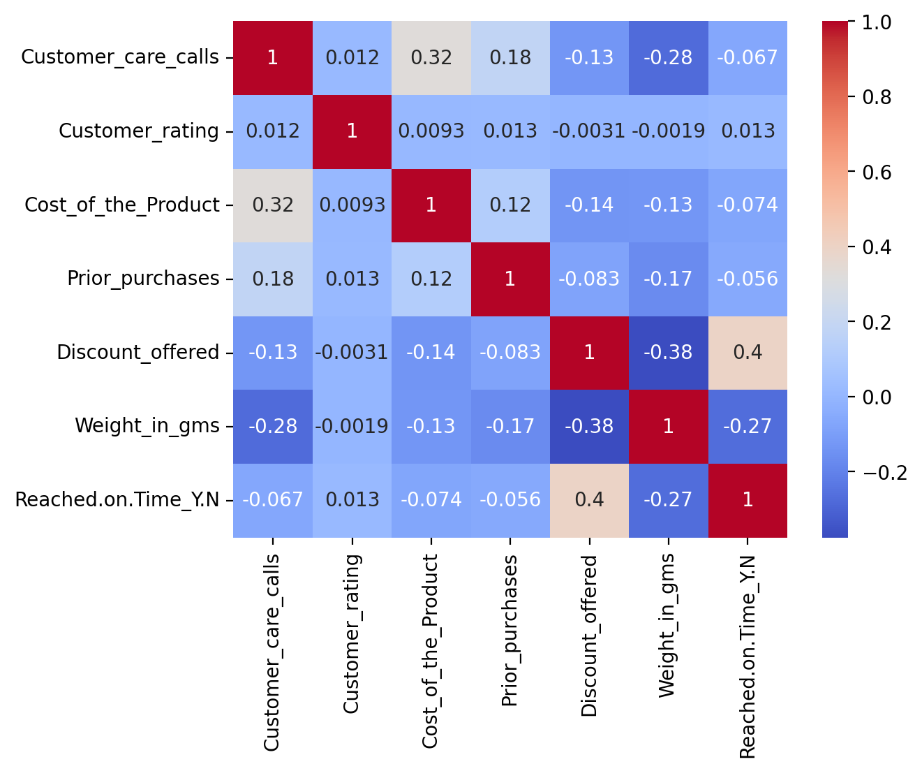
Correlation Analysis
Correlation Heatmap Observations:
Positive Correlation:
Product cost ↔ Customer care calls (indicating customer concerns for high-value items).
Negative Correlation:
Discounts ↔ Delivery delays (higher discounts improve punctuality).

Slide 9
Machine Learning Models
Models Used:
Decision Tree Classifier:
Selected optimal parameters via grid search.
Best depth: 6, minimum samples split: 2.
Random Forest Classifier:
Explored ensemble learning for improved accuracy.
Selected optimal parameters via grid search.
Best depth: 8, minimum samples split: 2.
Logistic Regression:
Interpreted linear relationships between features.
K-Nearest Neighbors:
Examined proximity-based decision-making.
Train-Test Split:
Training accuracy varied from 63% to 78%.
Test accuracy ranged between 63% and 69%.

Slide 10
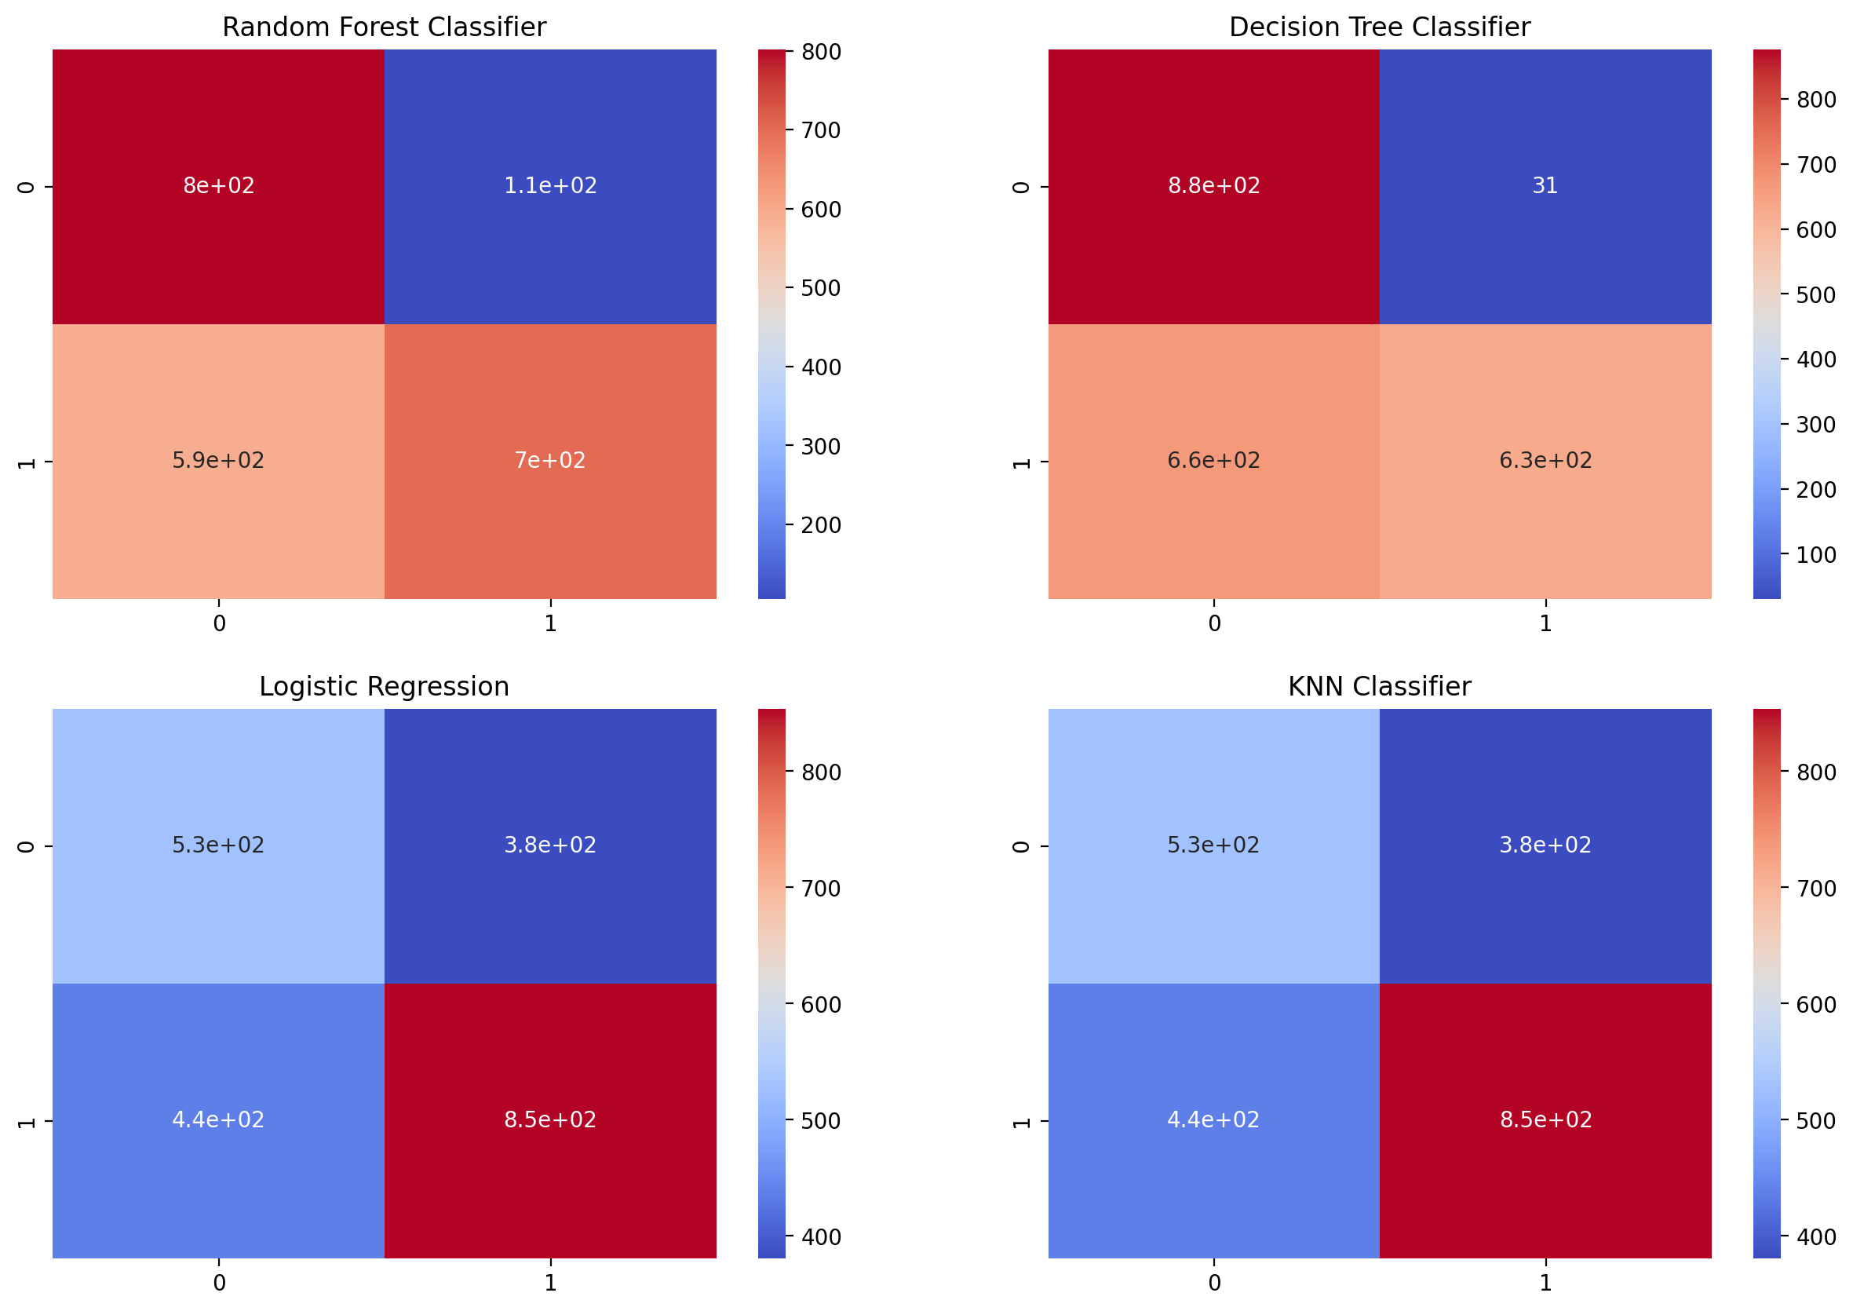
Model Evaluation

Slide 11
Model Performance
Performance Summary:
Decision Tree Classifier: Highest test accuracy at 69%.
Random Forest: Close second with 68% accuracy.
Logistic Regression: Moderate performance at 63%.
K-Nearest Neighbors: Lowest test accuracy at 63%.
Metrics Used:
Precision: Model's ability to predict on-time deliveries correctly.
Recall: Sensitivity to capture all true positives.
F1-Score: Balance between precision and recall.

Slide 12
Key Findings
Insights from EDA and Modeling:
Product Factors:
Products between 2500-3500 grams delivered on time more often.
High-value products ($250+) experienced delays.
Warehouse Logistics:
Warehouse F processed a majority of on-time deliveries, likely due to seaport proximity.
Customer Behavior:
Frequent customer care calls indicated delivery issues.
Repeat customers benefited from more reliable deliveries.
Discounts:
Offers >10% improved delivery punctuality.

Slide 13
Conclusion
The project's objective was to forecast on-time delivery for an e-commerce company's products and to explore factors influencing delivery times and customer behavior. The exploratory analysis highlighted that product weight and cost are crucial to delivery success, with products in the 2500-3500 gram range and priced under $250 being more likely to arrive on time. A significant volume of products was dispatched from warehouse F using shipping, suggesting its proximity to a seaport.
Customer behavior also sheds light on delivery outcomes. An increase in customer care calls often correlates with delivery delays. In contrast, customers with a history of multiple purchases tend to experience more punctual deliveries, which might explain their repeat business. As for discounts, products with minimal discounts (0-10%) saw more late deliveries, while those with discounts exceeding 10% were more often delivered on time.
Regarding machine learning models, the decision tree classifier outperformed others with a 69% accuracy rate. Close behind were the random forest classifier and logistic regression, with 68% and 63% accuracy, respectively. The K Nearest Neighbors model trailed with the least accuracy at 63%.

Slide 14
Recommendations
Optimize shipping routes for heavy products.
Enhance operations at high-performing warehouses (e.g., F).
Investigate and address customer care interactions to mitigate delays.

Slide 15
Questions ?

Slide 16
Thank You!

